Slide 1
Real Estate Investment Opportunities in 2024
Andrew Cheng
Paul Samaniego
Riya Gajjar
Madeline Cruz

Slide 2
Real Estate Investment Opportunities In 2024
How viable is investing in real estate? (summary stats)
What are the barriers to entry?
What cities experienced the fastest and slowest growth? (moving avgs)
Which cities historically have the most volatile markets? (hist plots)
When is a good time to buy? (hist plots)
How do we expect prices to move next year? (regress analysis)

Slide 3
Summary Statistics

Slide 4
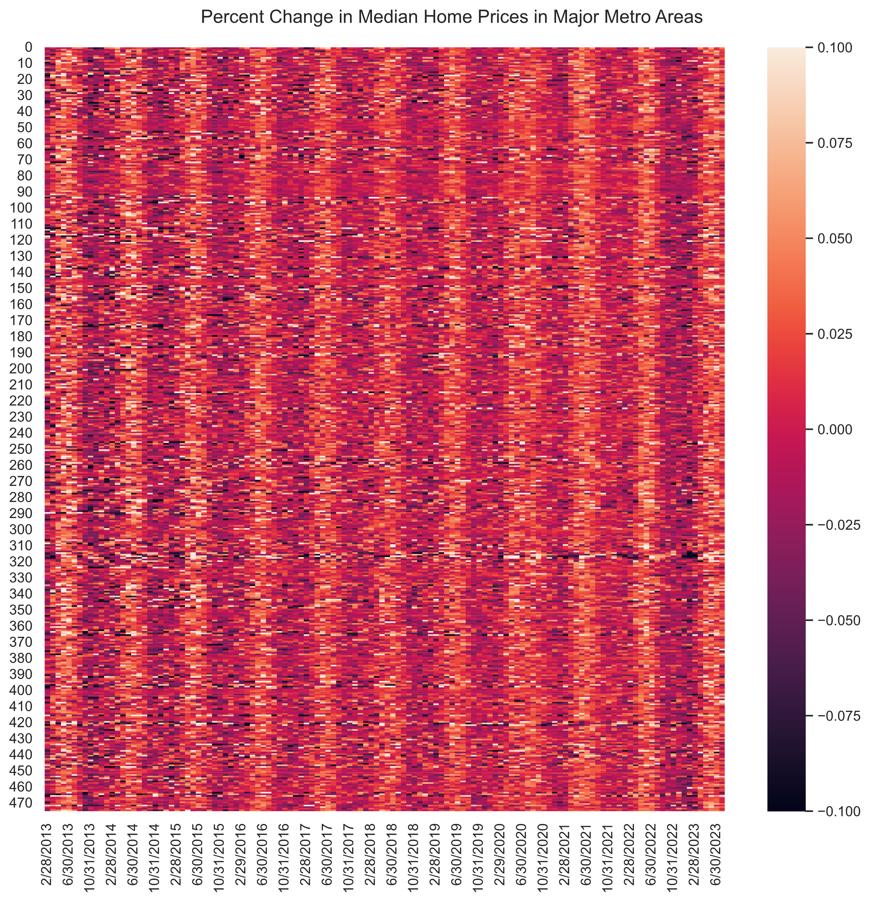
Market Volatility Summary Unranked
Regular pattern over the past ten years

Slide 5
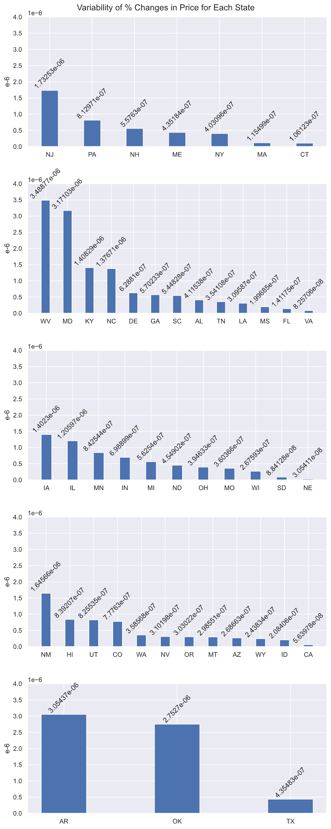

Volatility of Individual States Grouped by region

Slide 6
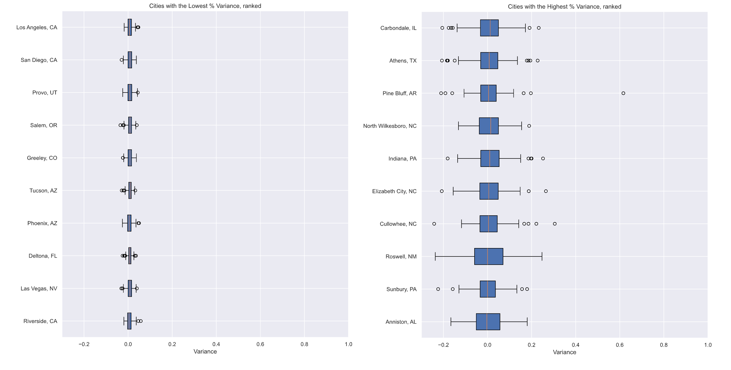
Most Stable City Prices, Historic
Most Volatile City Prices, Historic

Slide 7
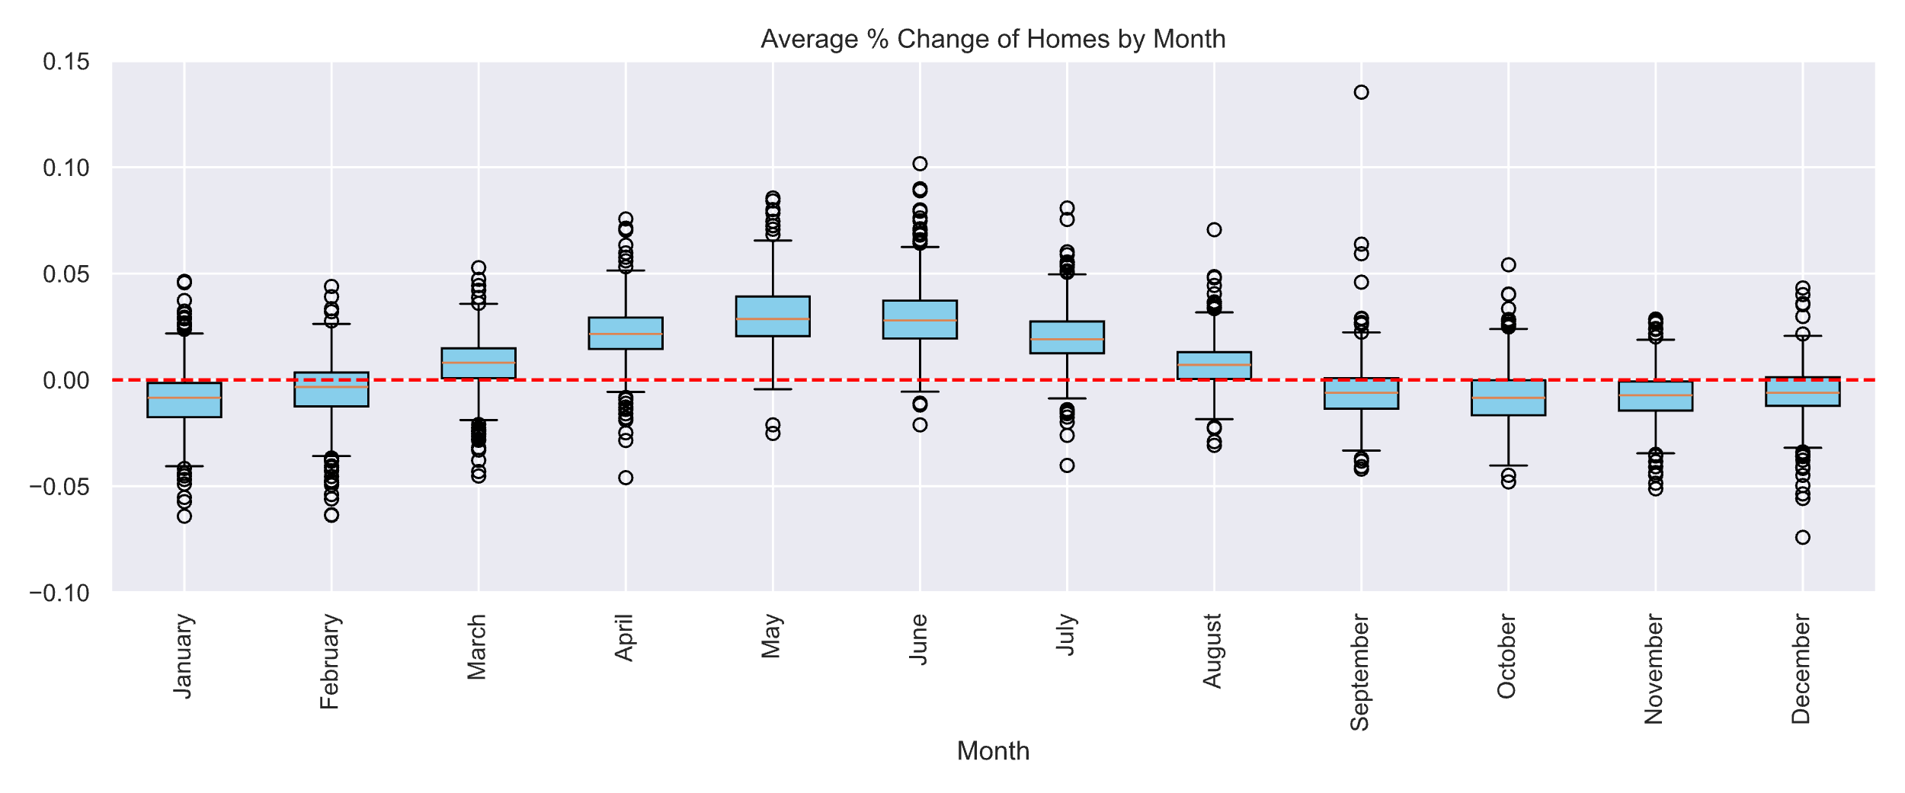
Average % Change in Prices, Historic
Notes:
Taken by aggregating data from 2013 to 2023 and splitting them by month. Although this is just a 2-3% reduction in price, if youre interested in min-maxing your returns, you should buy around this time.

Slide 8
Conclusions
Buy a property between the months of Sept to January
Somewhere in the Midwest/ South,
Predicted returns if held on for one year?

Slide 9
Considerations
Data is derived from Zillow Median Home Data between 2013 and July 2023.
Prices do not consider local/ state property taxes and laws.
Data is not normalized to accommodate population of each city.
Data does not include underlying political/social/economic/environmental drivers in price:
Ie: supply/demand in the area, size of homes, age, amenities, neighborhood quality, population density, interest rates, etc.
Property investments are not liquid and may take months, maybe years to sell.

